Slide 1
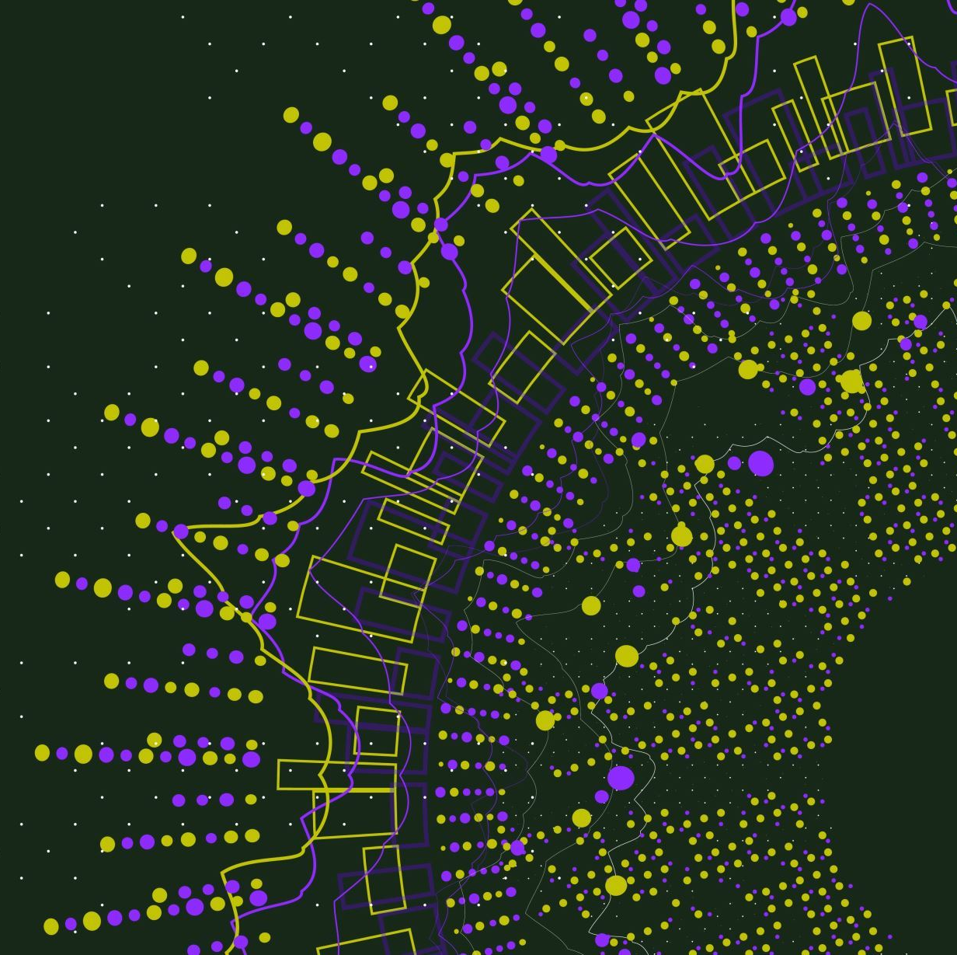
Implementation of Different Scheduling Algorithms in Linux Kernel
CSE 4300
Jiawen Chen
Ervin Jimenez
Jesse Kuhns

Slide 2
Goal
Our team decided to explore the different algorithms mentioned in the lecture, and decided to try to implement them in the linux kernel and visualize how each perform compared to each other with data.

Slide 3
Before we start: Linux's Default Scheduler
Modular scheduler called Completely Fair Scheduler
A core.c to handle scheduling, interrupts and context switches, calls different scheduler classes files ( in the kernel/sched folder) to see which task to run next.
FCFS and Shortest Job First are not implemented in default linux kernel

Slide 4
Presentation Overview
Algorithms Implemented
Testing Methods
Linux Kernel Implementation
EBPF Implementation
Testing results

Slide 5
Testing Methods
About the test script for the scheduler: how is efficiency measured? How many processes are run?

Slide 6
Algorithms
FCFS
Priority
Round Robin
Shortest Job First

Slide 7
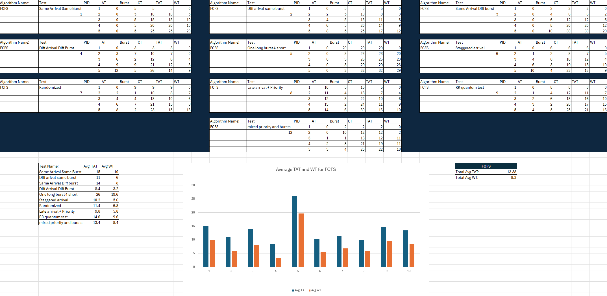
Algorithm : FCFS

Slide 8
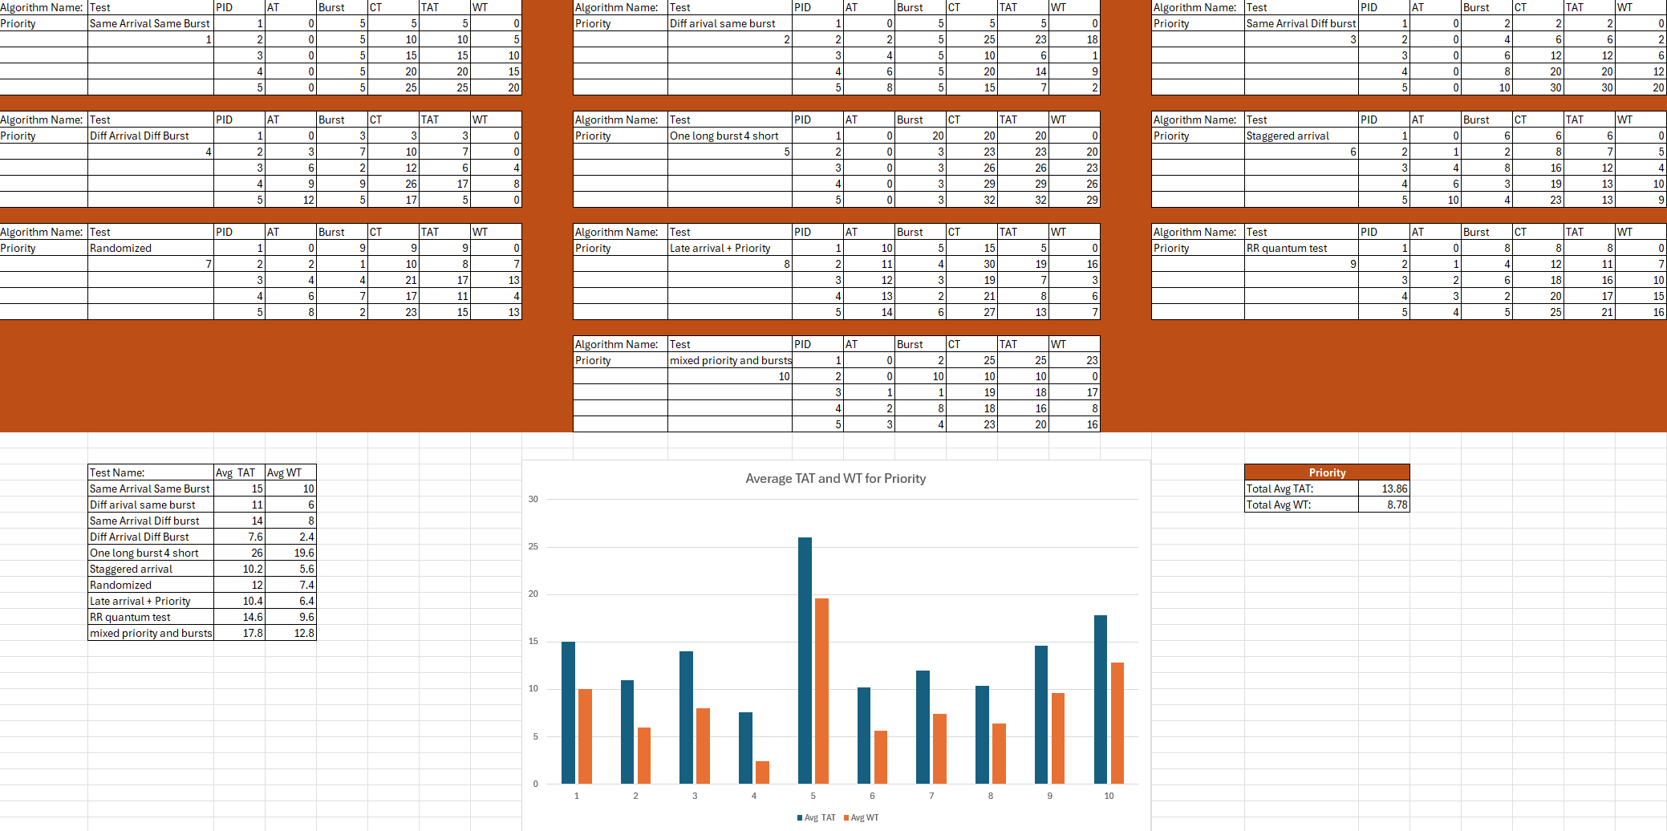
Algorithm : Priority

Slide 9
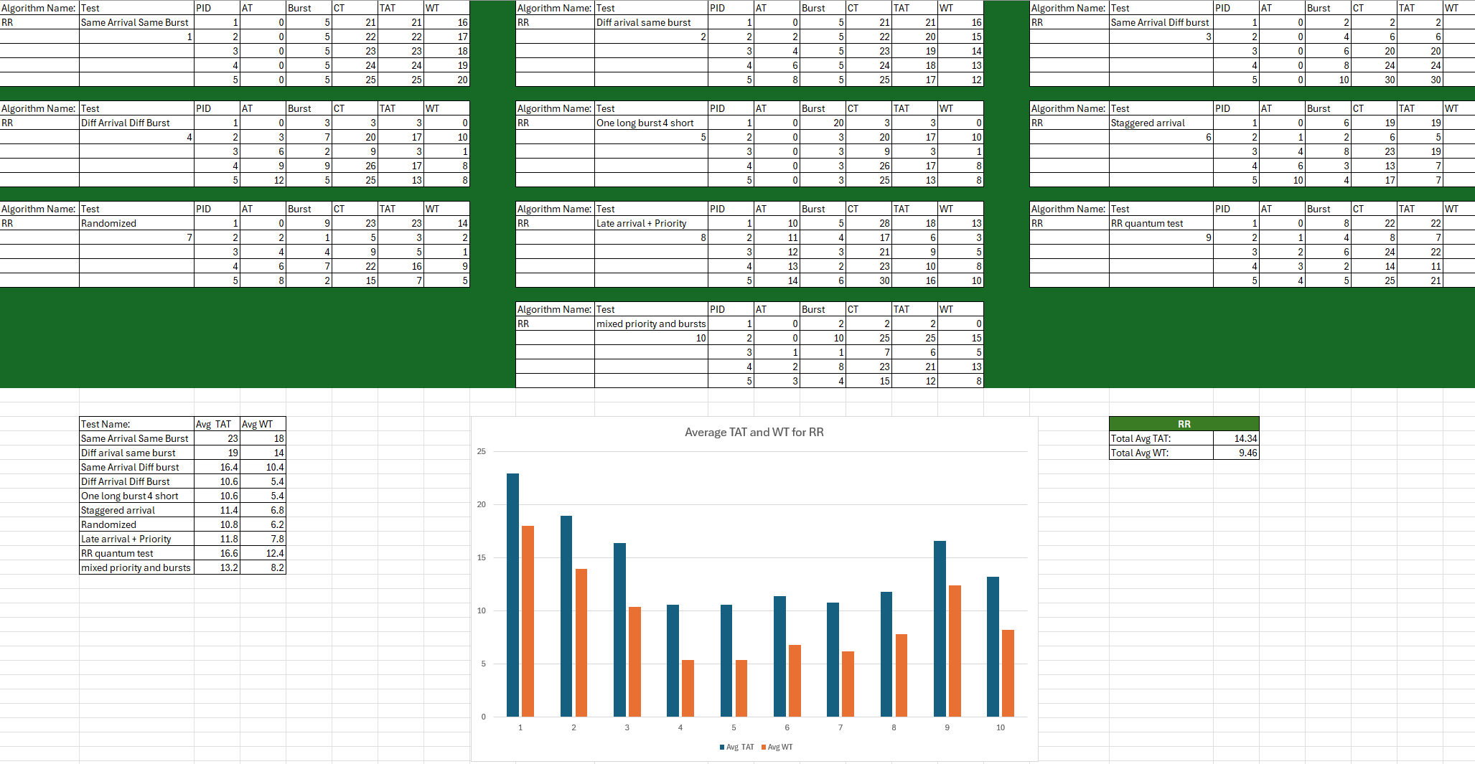
Algorithm : RR

Slide 10
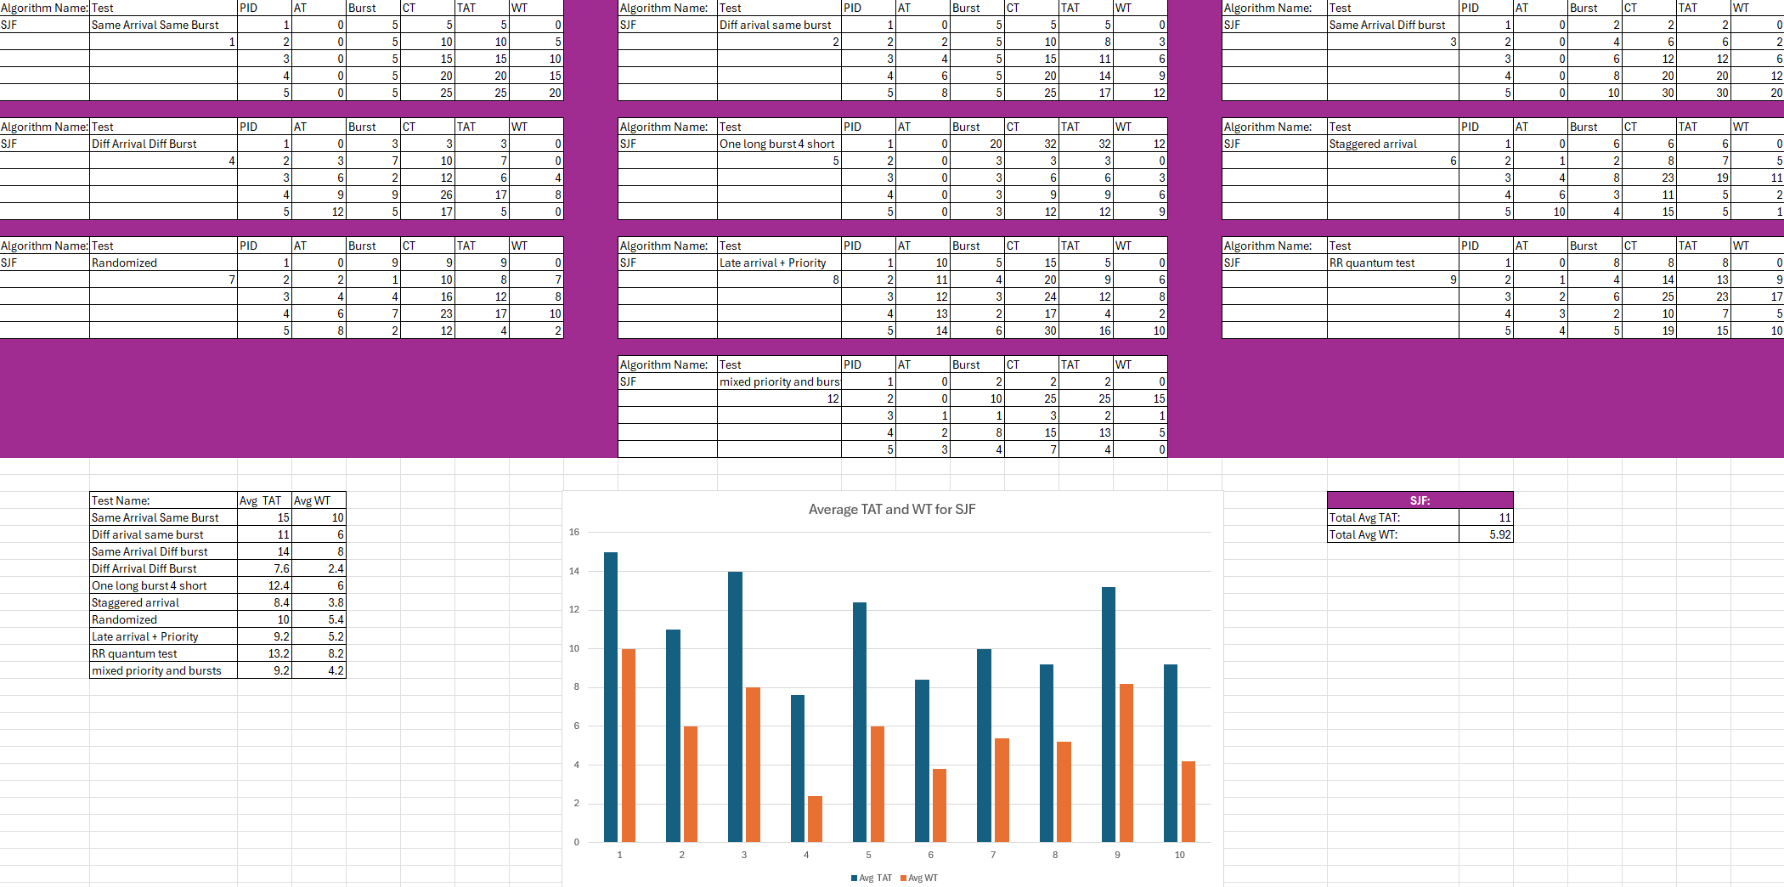
Algorithm : SJF

Slide 11
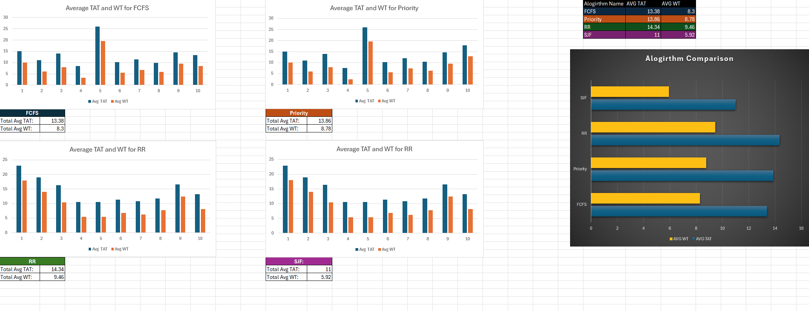
Results

Slide 12
Linux Kernel Implementation
Actually putting the algorithms to use in the Linux Kernel requires modifications to the kernel files.
Our team has found two ways : modifying many individual files in the linux kernel, and a safer, more efficient method of using EBPF

Slide 13
Linux Kernel Implementation
Requires thousands of lines of code
rt.c, the scheduling class for just FIFO and RR, is 2,938 lines long
sched.h, the header file for scheduler types and methods, is 3,903 lines
Changes made directly to the kernel are very risky
Work can be reduced by piggybacking off existing schedulers
Still a mammoth undertaking!
You need to know how it works to know what to take

Slide 14
Linux Kernel Implementation
Requires changes to files in the kernel/sched/ directory,
Mainly, changes to core.c, sched.h, and fair.c
Status changes are made in sched.h in /include/linux/sched.h so that arrival time can be recorded for tasks marked as using the desired scheduling algorithm

Slide 15
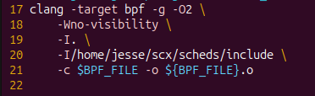

eBPF Implementation
Significantly more straightforward
Allows you to leverage existing infrastructure in a safer, easier way
Extensible scheduler class (sched_ext)
Schedulers can be written in dozens of lines of code, rather than thousands
To use it, all you have to do is compile it with clang, and register it with the kernel
Once running, they keep working until you manually stop them

Slide 16
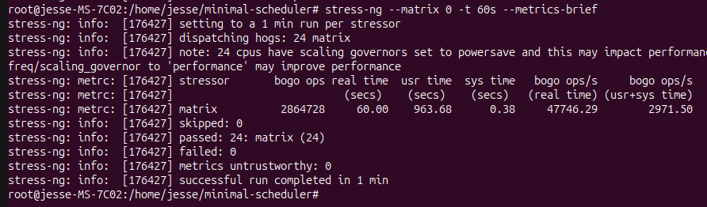
Schedulers tested
CFS – Completely Fair Scheduler – The default Linux scheduler
RR – Round Robin – Tasks can run until their time slice expires
FIFO – First in, First out – Tasks run in order and to completion
Prio – Priority Queue – Tasks are given a priority when they're enqueud
Testing was done with the stress-ng --matrix tool
- Performs millions of floating point operations

Slide 17
Testing Results

